Slide 1
SDHCAL for ILD
I.Laktineh
IPNLyon
OUTLINE
SDHCAL for ILD
SDHCAL-GRPC prototype
Prototype results
Preparation for ILD
Present and future development
Conclusion

Slide 2
SDHCAL Milestones
2006 : Start of the SDHCAL development with the aim to achieve the first
technological prototype using the semi-digital readout concept;
2007 : Development of small detectors and associated electronics readout;
2008-2011 DHCAL ANR-blanc;
2010 : International review (organized by the IN2P3),CALICE internal review;
2011 : Construction of the SDHCAL prototype;
2012 : Test Beam at CERN;
2013 : Prototype data analyses and R&D for final validation of the SDHCAL-ILD.
Several groups of the CALICE collaboration contribute to the project :
France : IPNL, LAPP, LLR, LPC, OMEGA;
Spain : CIEMAT;
Belgium : UCL, Gent;
China : Tsinghua university, NCEPU;
Tunisia : Tunis university.

Slide 3
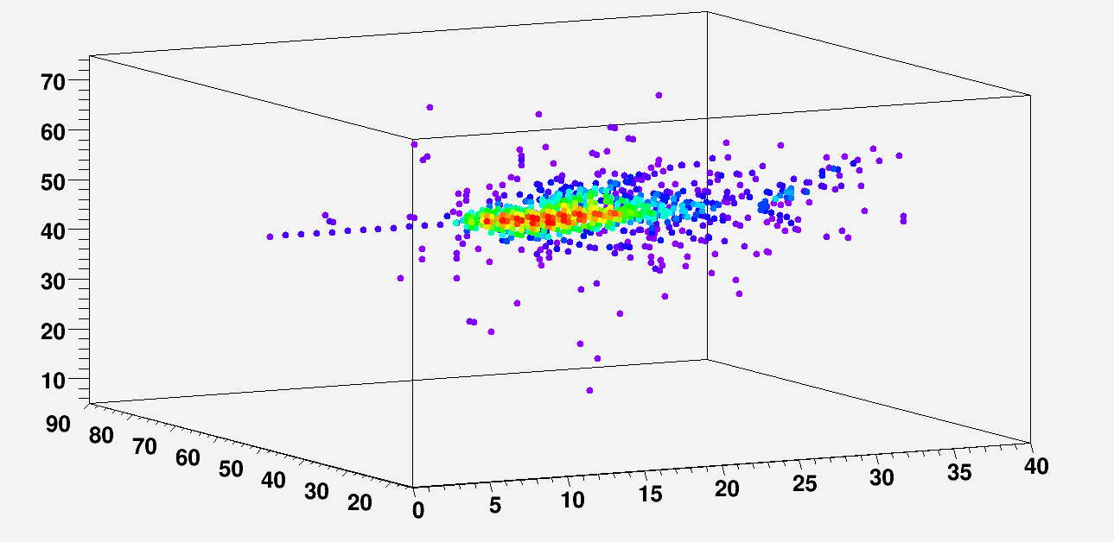
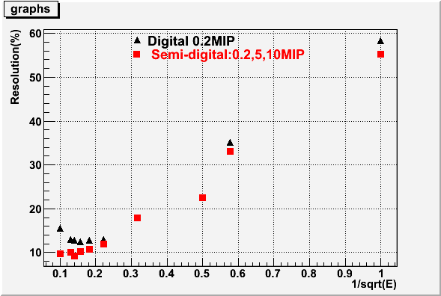
SDHCAL concept
1- Detector choice
Gaseous detectors: homogenous, cost-effective and highly transverse and longitudinal granular.
GRPC : is an adequate candidate for ILC.
2- Electronics readout choice
At high energy the shower core is very dense
→ Simple binary readout will suffer saturation effect
→ Semi-digital readout (2-bit) can improve the energy
resolution.
Avalanches
30 GeV
1 cm² pad
Simulation

Slide 4
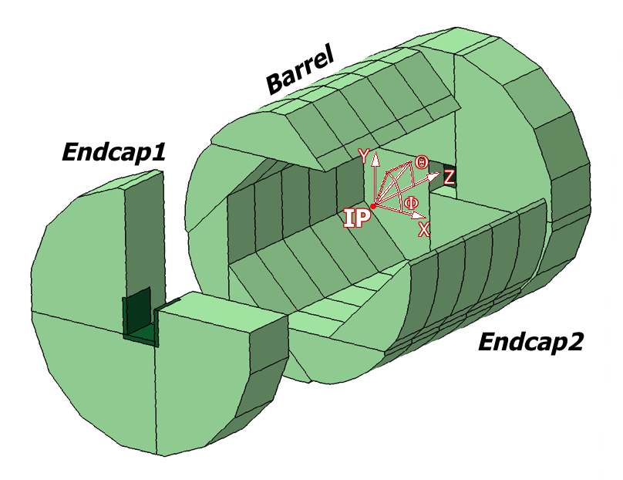
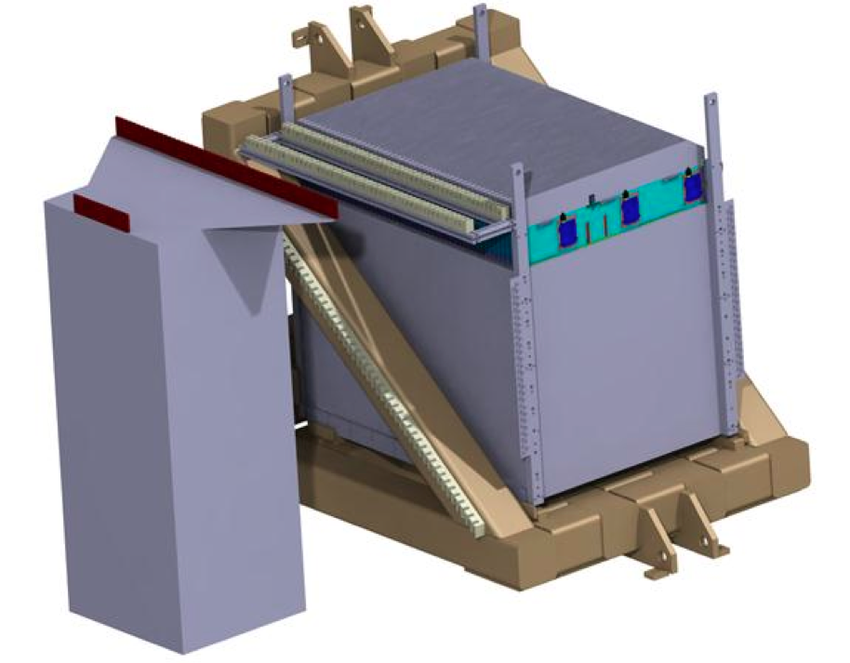
SDHCAL-ILD
The SDHCAL-GRPC is one of the two HCAL options proposed
in the ILD Letter Of Intention (LOI). Modules are made of
48 RPC chambers (6λ_{I}) equipped with
power-pulsing electronics readout.
The structure proposed for the SDHCAL-ILD :
Is self-supporting
Has negligible dead zones
Eliminates projective cracks
Minimizes barrel / endcap separation
(services leaving from the outer radius)
SDHCAL Prototype
- Come as close as possible to the ILD module
and be able to study hadronic showers
-48 units (active layer + absorber)
fulfilling the ILD requirements.
Challenges
-Homogeneity for large surfaces
-Thickness of only few mms
-Services from one side
-Embedded power-cycled electronics
-Self-supporting mechanical structure

Slide 5
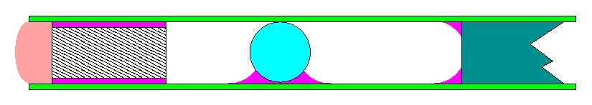
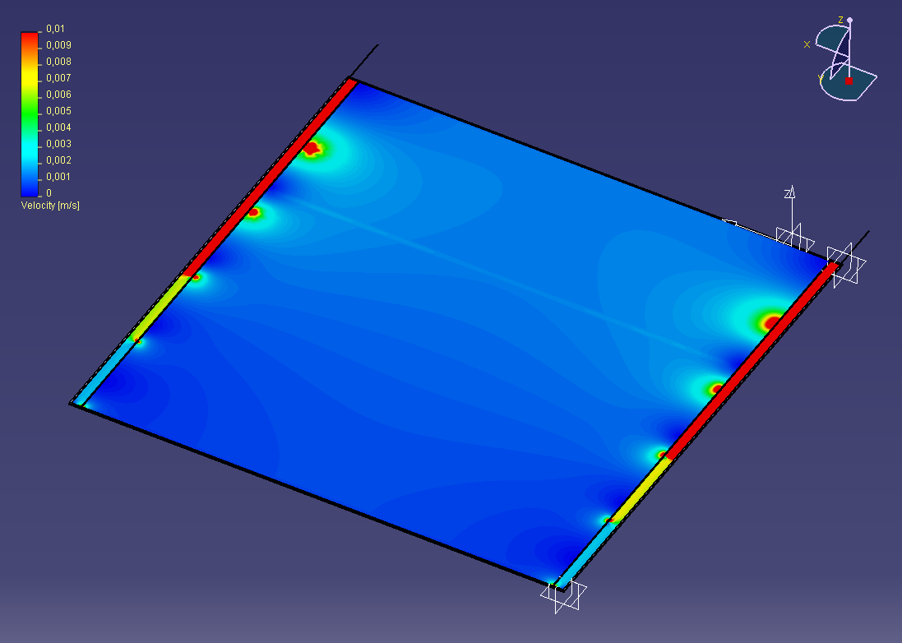
GRPC development
Silicone glue
Anode
Ceramic ball
Re-inforcing disk
Max. deformation: 44μ
RPC wall
Epoxy
Cathode
Epoxy
Deformation studies
Epoxy
Dead zones minimized
New resistive painting was developed
Genuine gas distribution

Slide 6
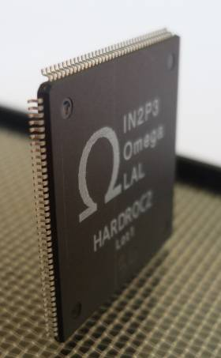
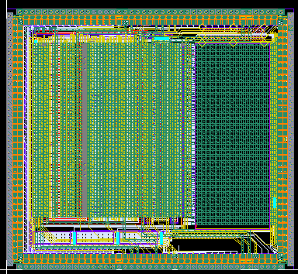
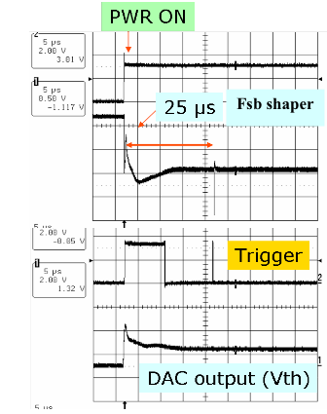
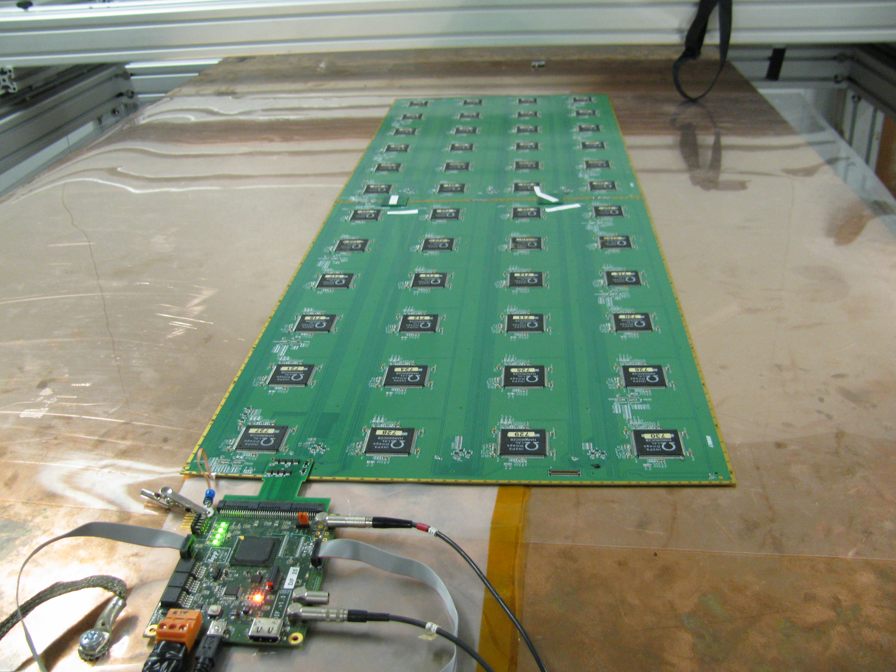
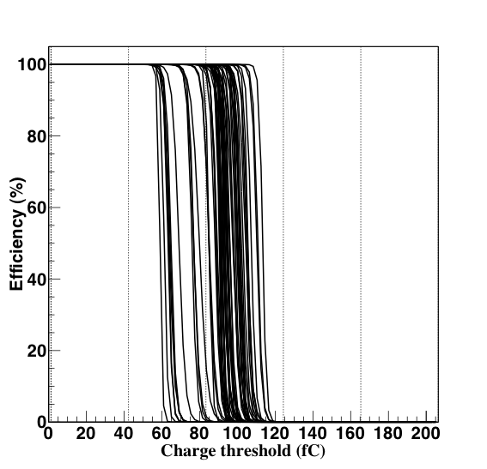
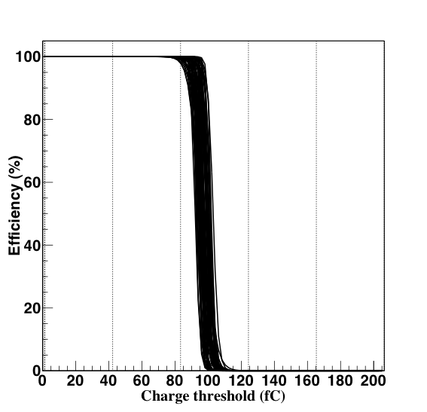
Electronics readout development
ASIC: HARDROC
64 channels, trigger less mode, memory depth:
127 events
2-bit readout : 3 thresholds
Dynamic range: 10 fC-15 pC
Gain correction → uniformity
Power-pulsed → reduced power consumption
4.7 mm
4.3mm
Printed Circuit Boards (PCB) were designed to reduce the x-talk with 8-layer structure and buried vias.
Tiny connectors were used to connect the PCB two by two (the 24X2 ASIC are daisy-chained).
DAQ board (DIF) was developed to transmit fast commands and data to/from ASICs.
6mm(active area) + 5mm(steel) =
11 mm thickness

Slide 7
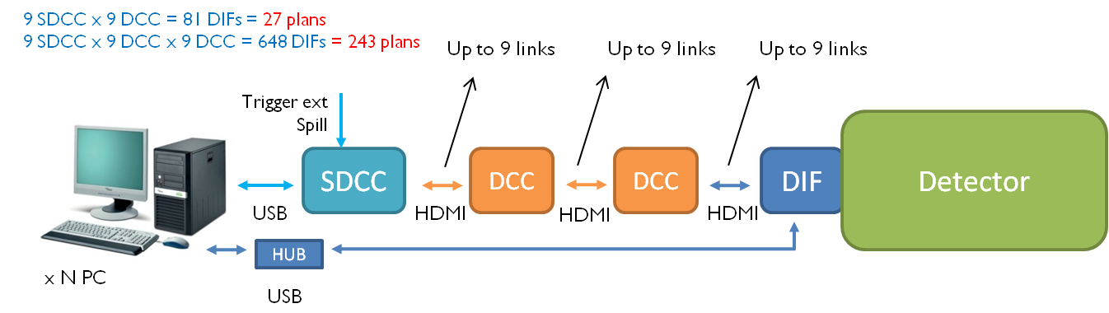
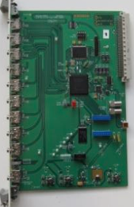
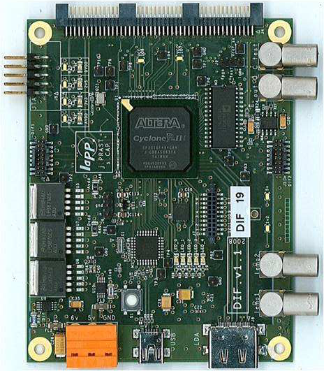
SDHCAL acquisition system
Acquisition software was developed to deal with the output of large
number of electronics channels (> 460 000).
Oracle database used for ASIC configurations and slow control.
→ CMS Xdaq used to provide the DAQ framework.

Slide 8
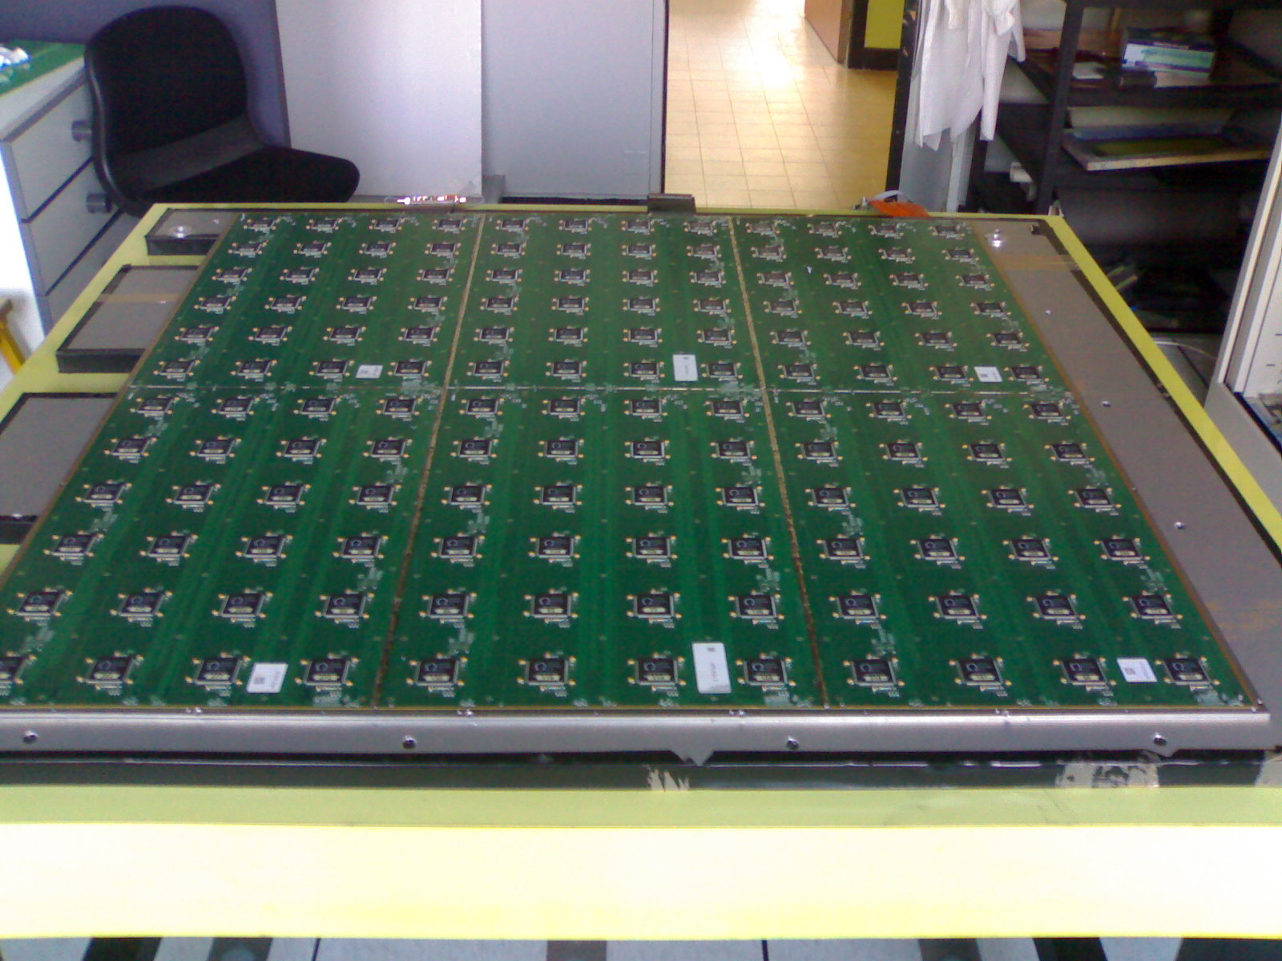
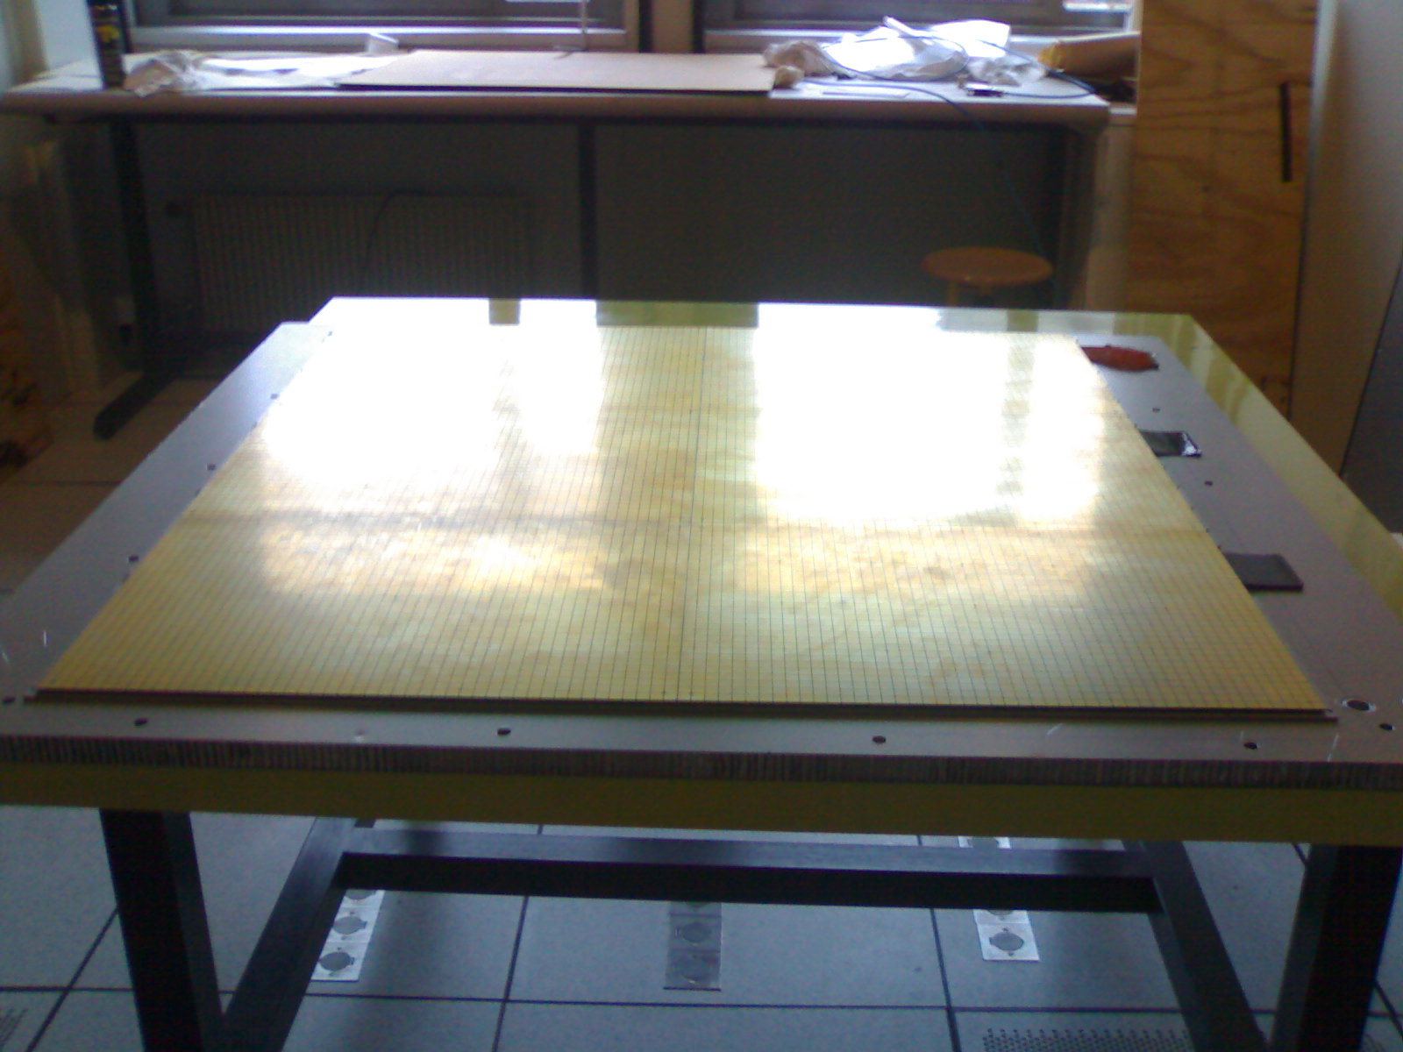
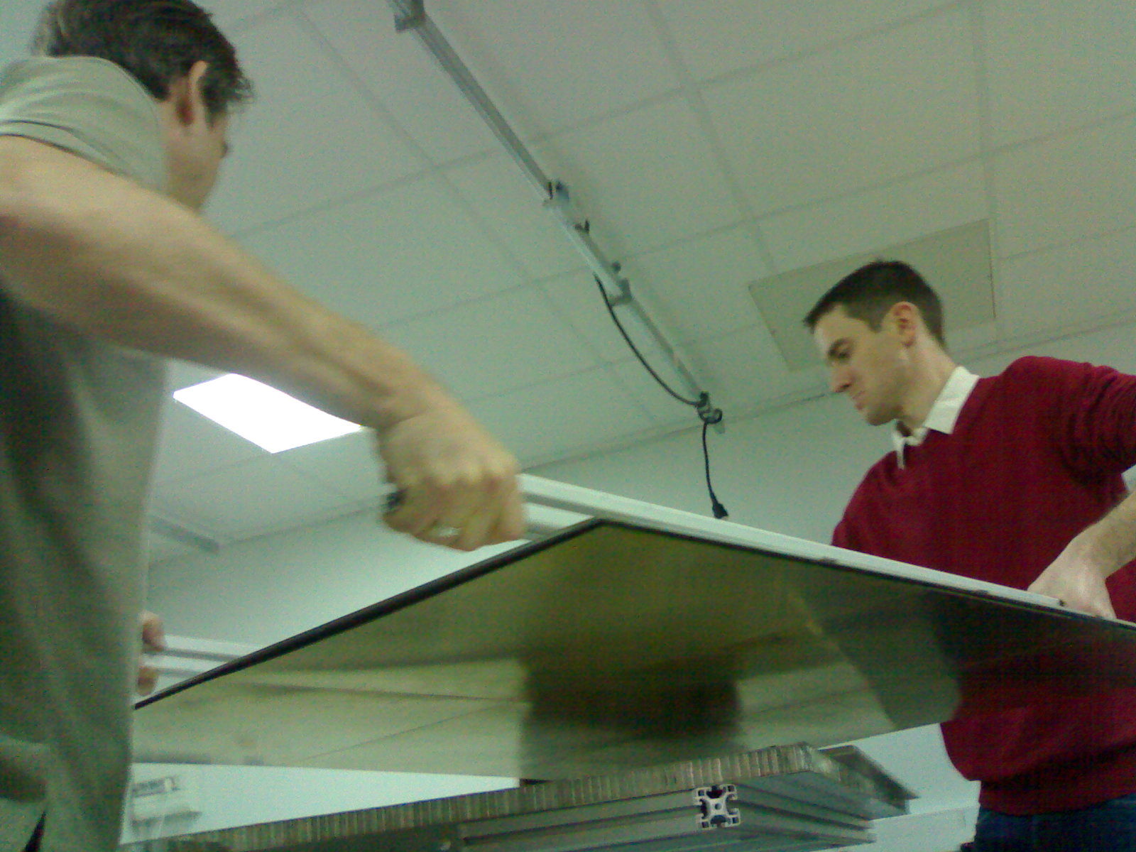
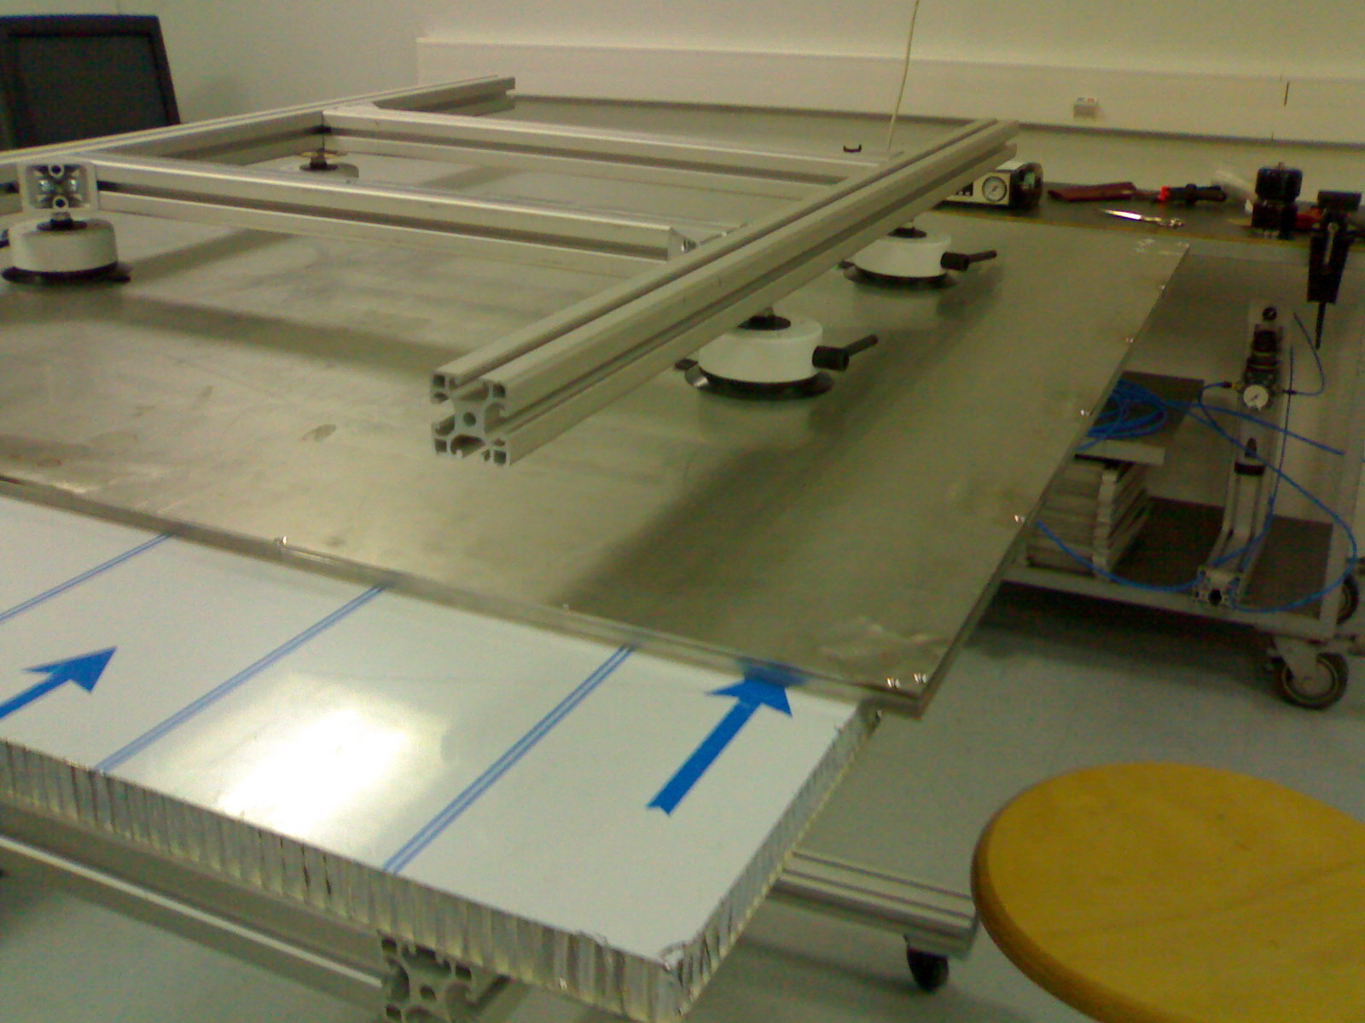
Cassette development
→ To provide a robust structure.
→ To maintain good contact
between the readout electronics
and the GRPC.
→ To be part of the absorber.
→ It allows to replace detectors
and electronics boards easily.
144 ASICs= 9216 channels/1m²
6mm(active ara) + 5mm(steel) =
11 mm thickness
The cassettes are built of no-magnetic stainless steel walls 2.5 mm thick each → Total cassette thickness = 6mm (active layer)+5 mm (steel) = 11 mm

Slide 9
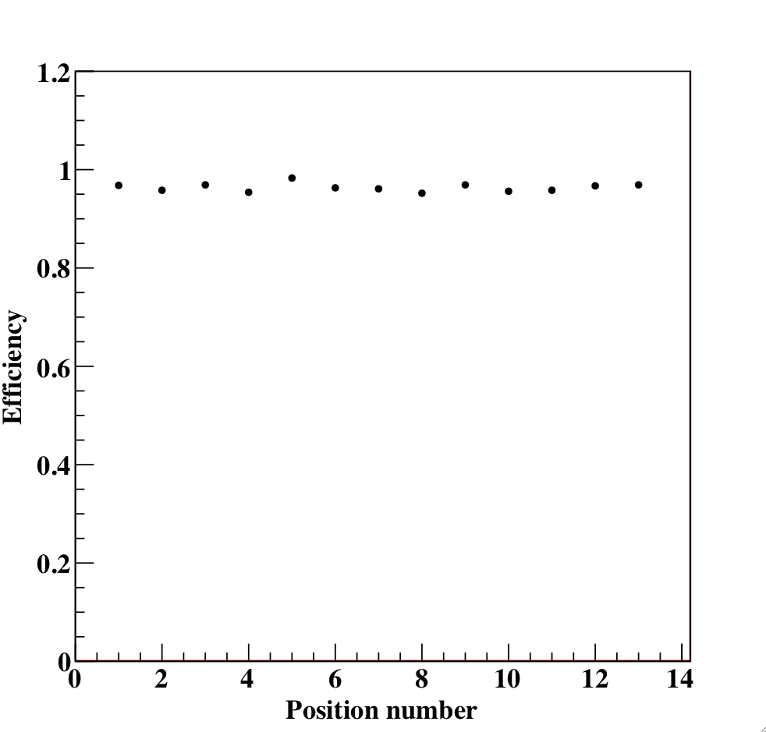
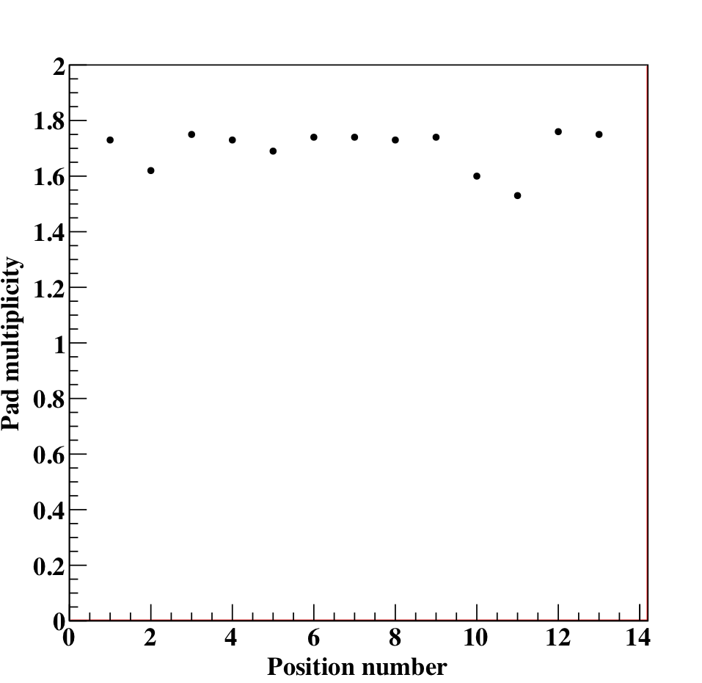
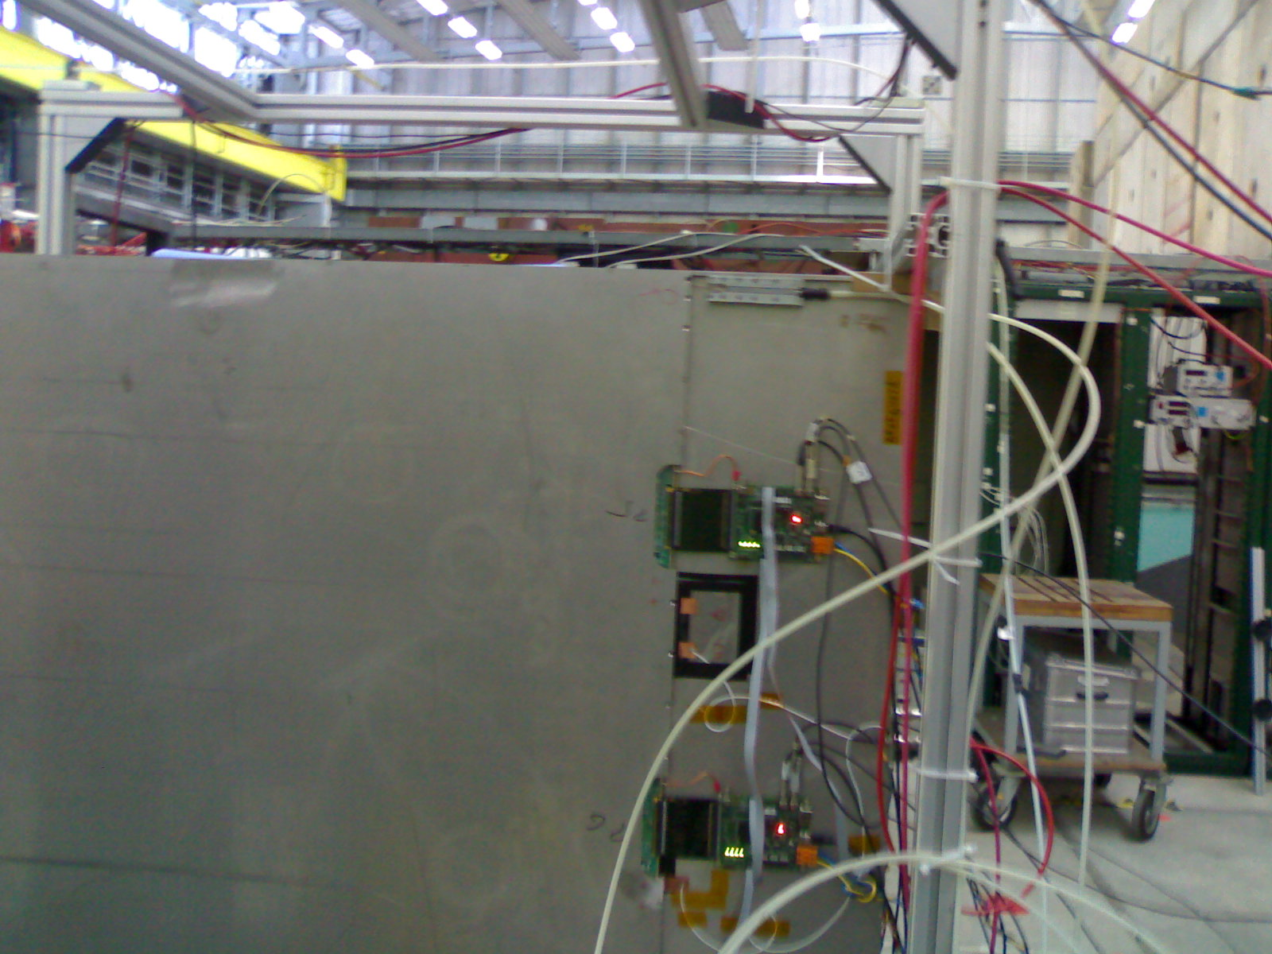
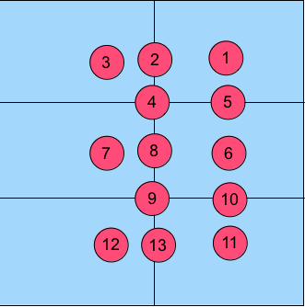
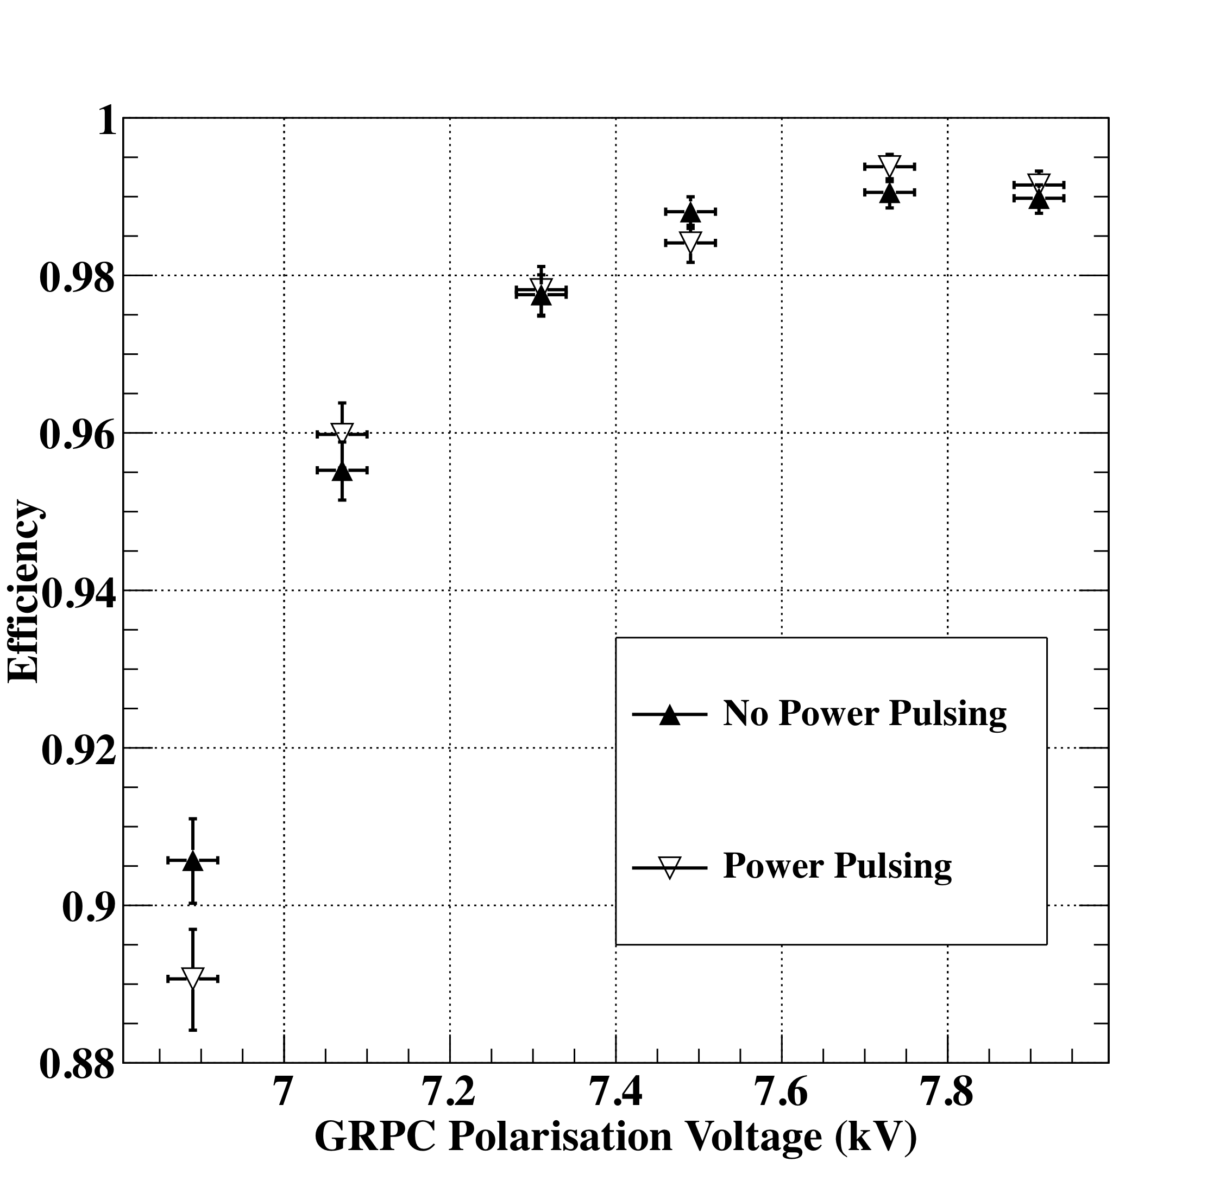
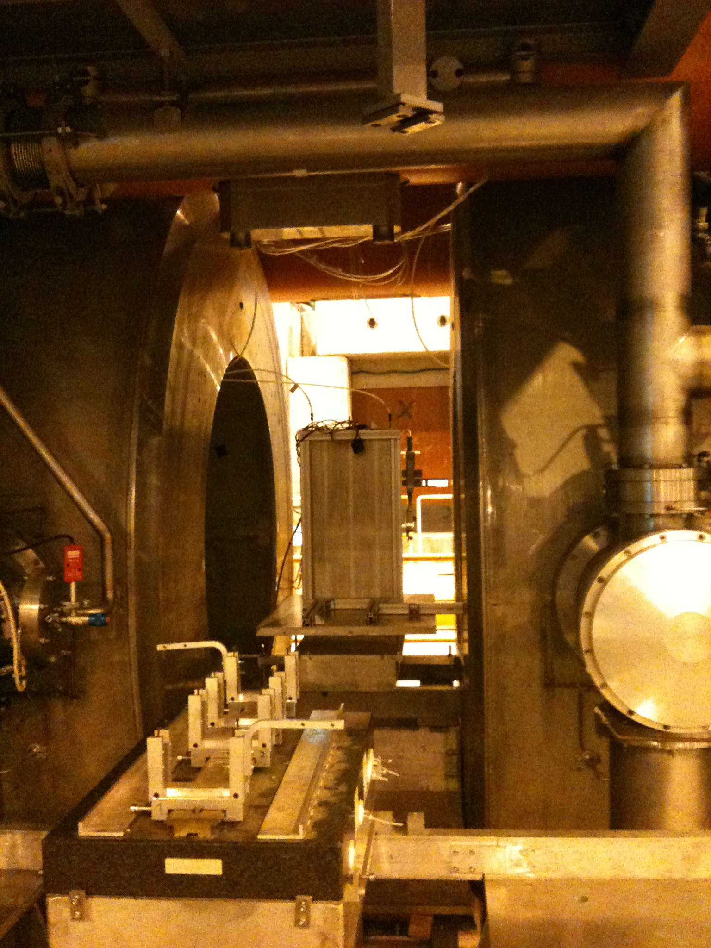
Test Beam validation
The homogeneity of the detector and its readout electronics were studied
HV : 7.4 kV
Beam spot position
Efficiency
Multiplicity
Power-Pulsing mode was tested in a magnetic field of 3 Tesla
The Power-Pulsing mode was
applied on a GRPC in a 3 Tesla
field at H2-CERN
(2 ms every 10 ms)
No effect on the detector
performance
9
Notes:
9
9

Slide 10
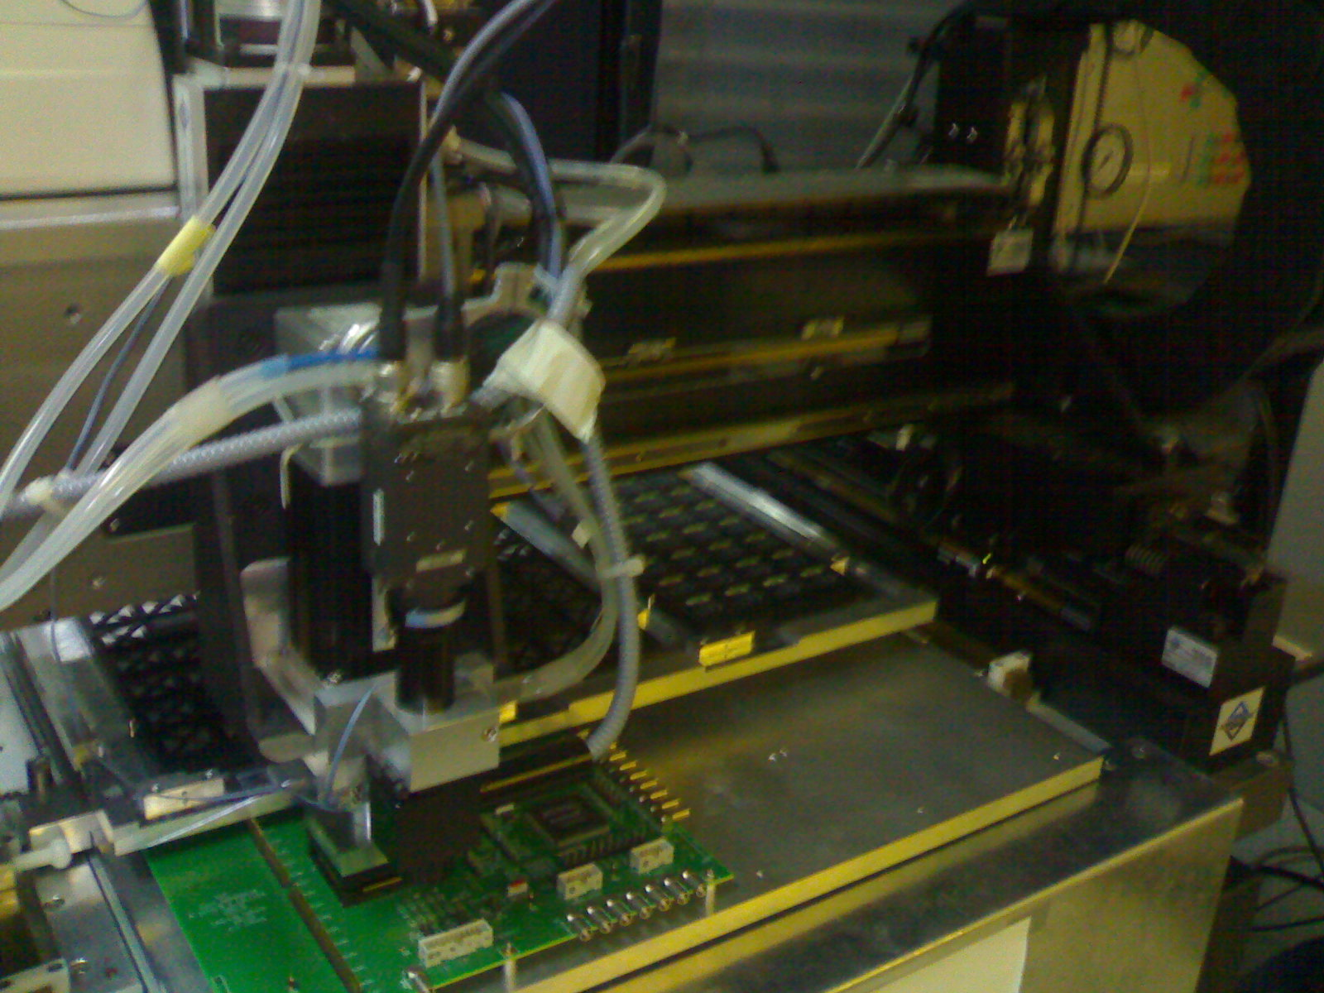
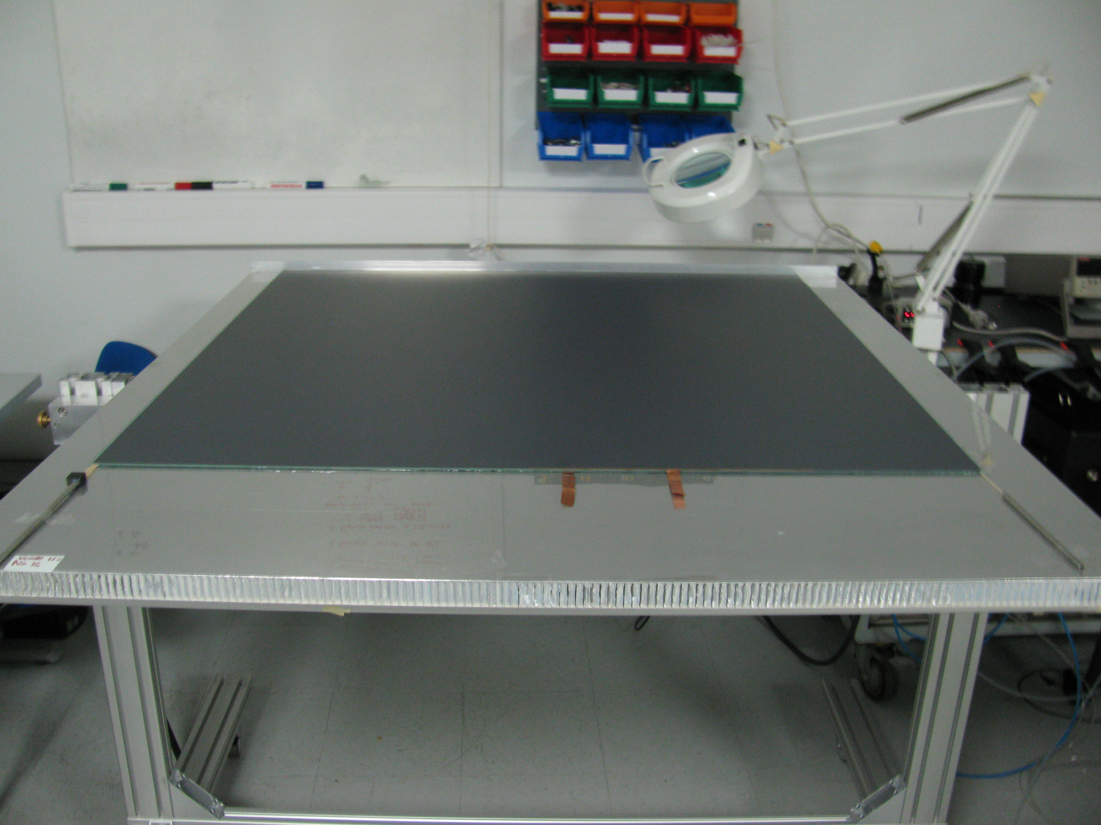
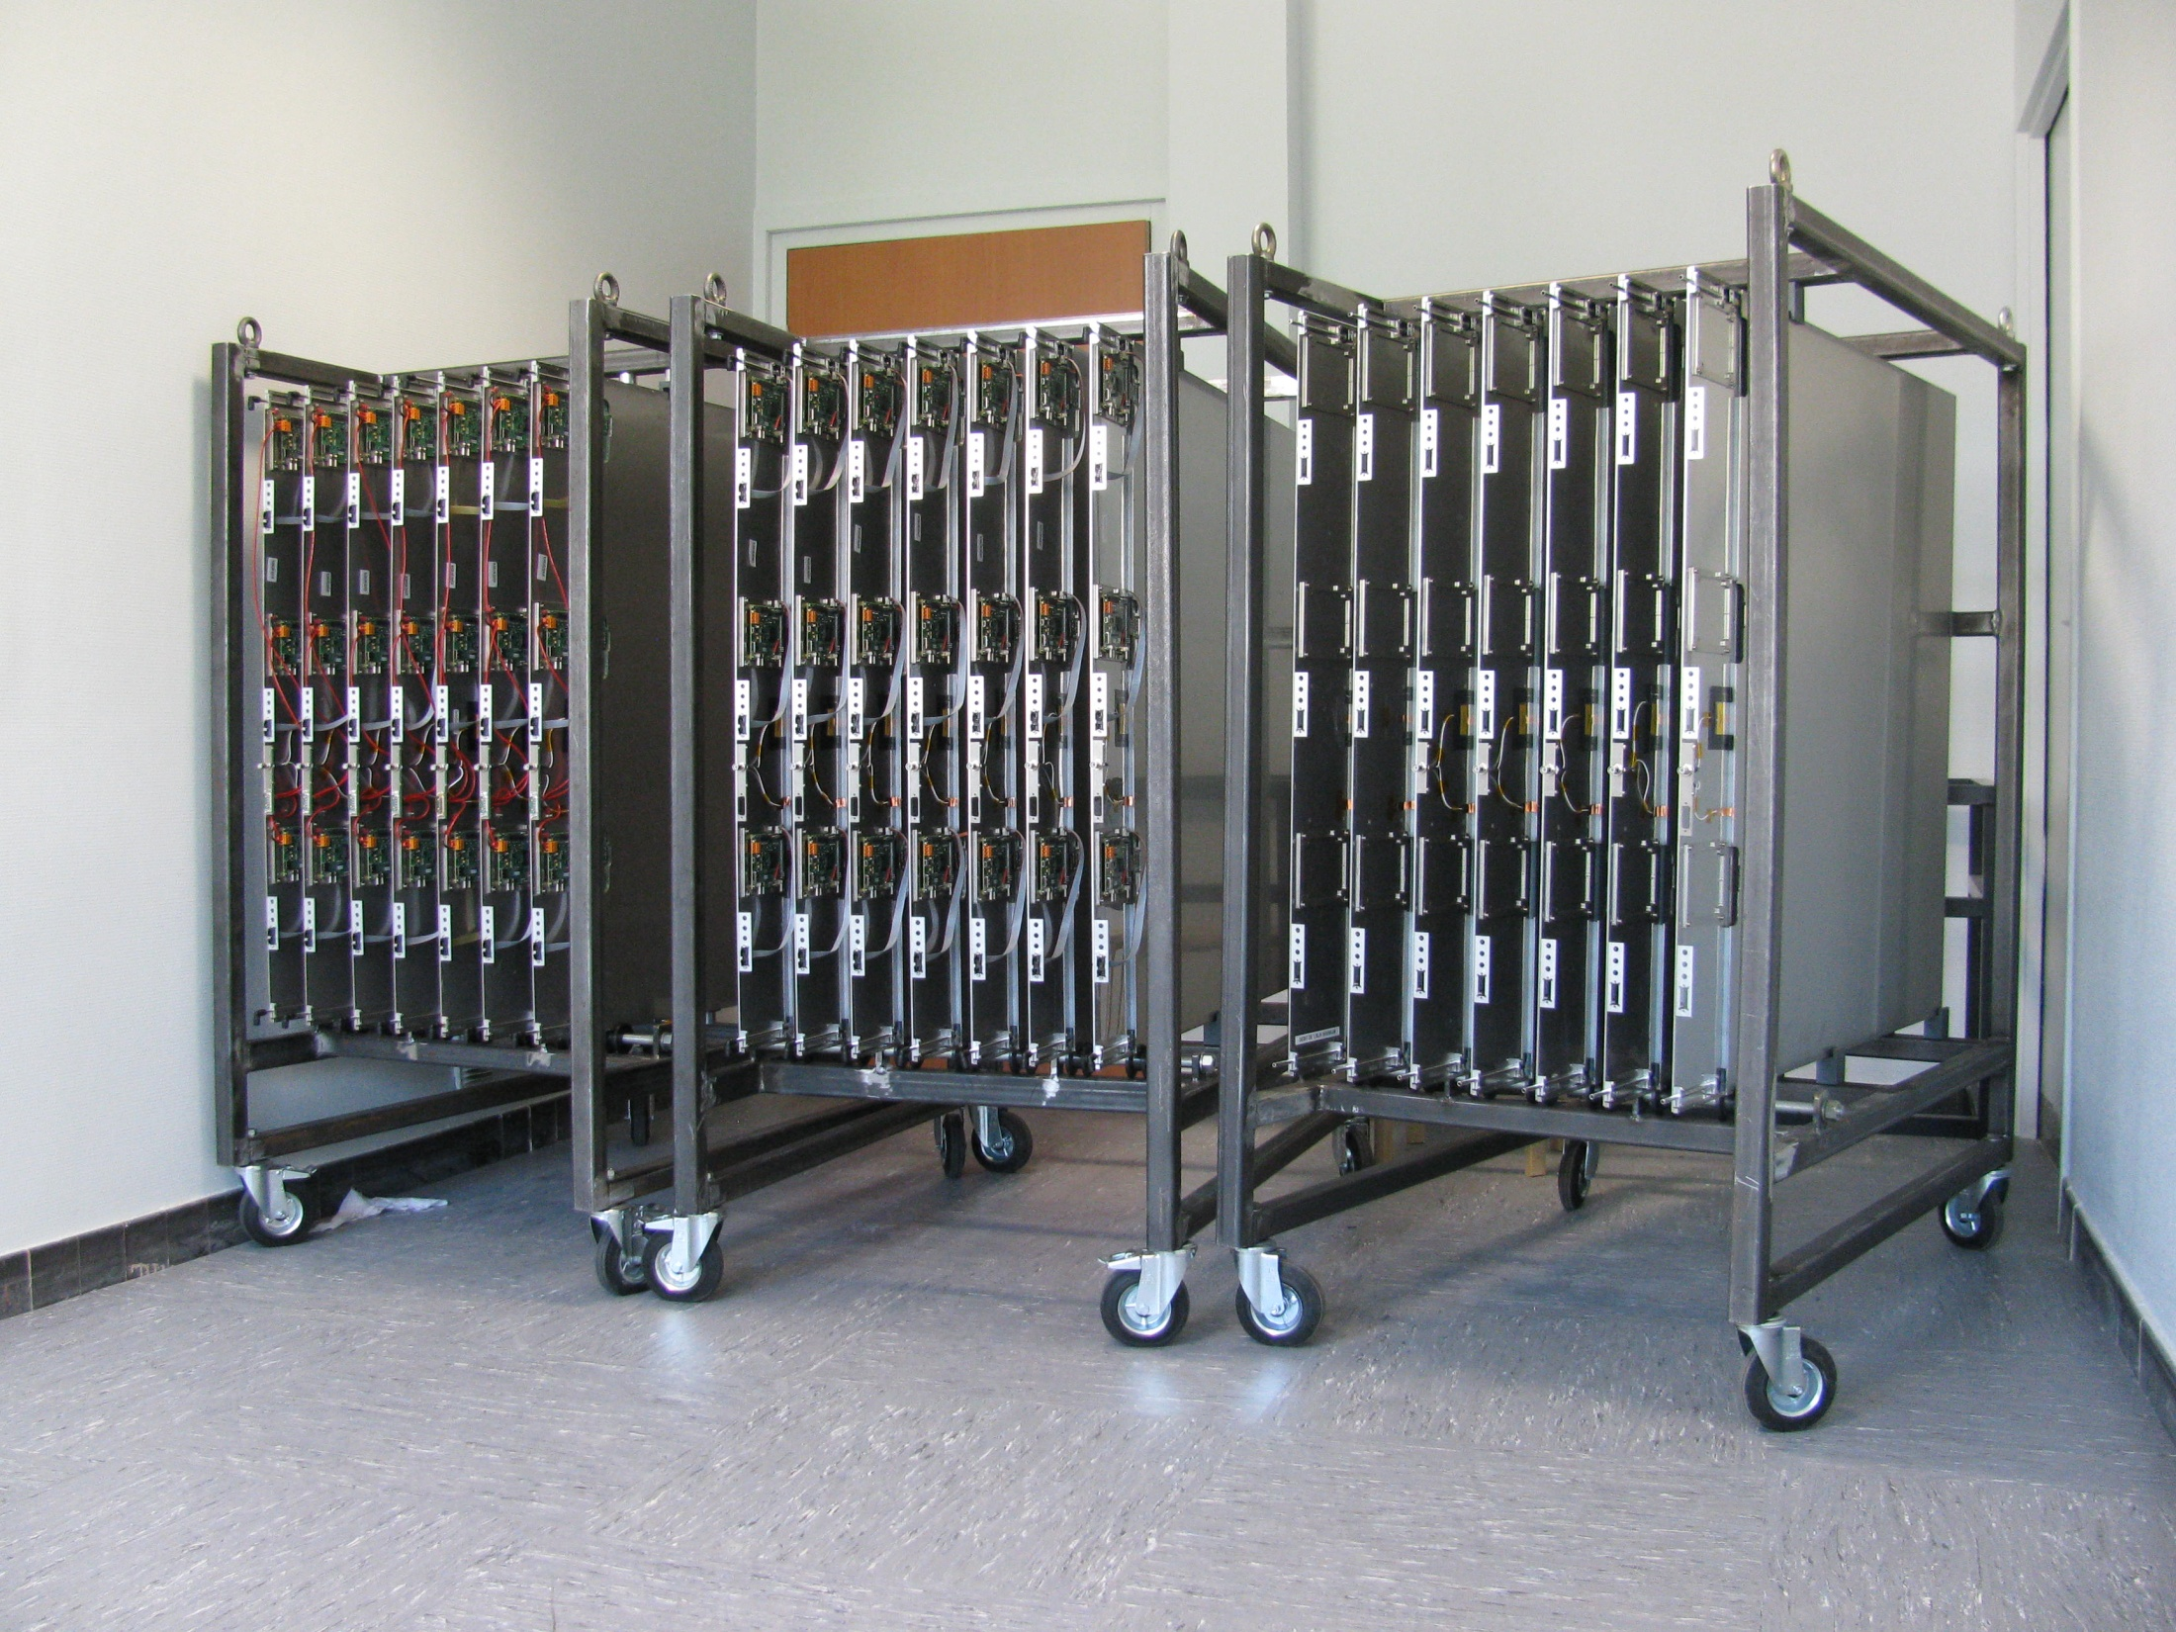
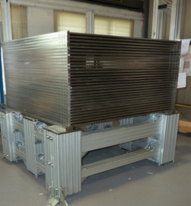
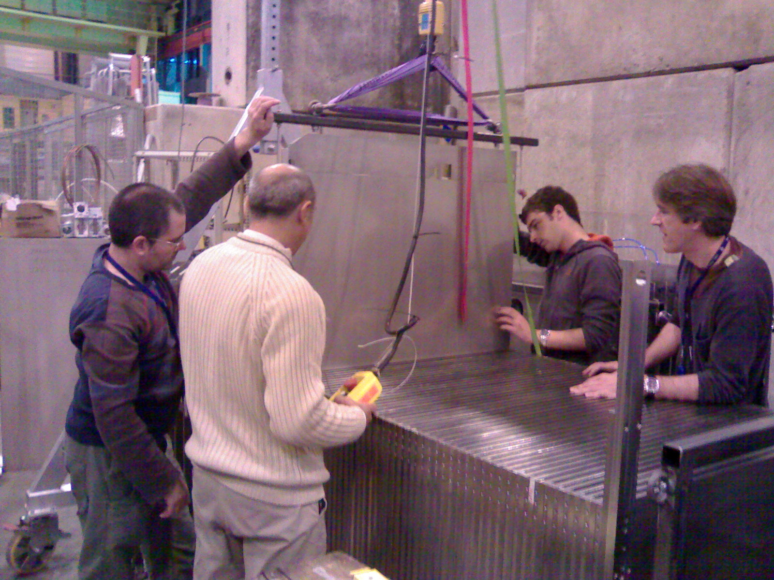
SDHCAL prototype construction
10500 ASIC were tested and calibrated using a
dedicated robot that was used by CMS (IPNL, OMEGA)
(ASICs layout : 93% ).
310 PCBs were produced, cabled and tested (IPNL).
They were assembled by sets of six to make 1m²
ASUs
170 DIF(LAPP), 20 DCC(LLR) were built and tested.
50 detectors were built and assembled with
their electronics into cassettes. Cassettes were tested
by sets of 6 using a cosmic test bench (IPNL).
The mechanical structure was built in CIEMAT.
HV, cooling services were built by UCL, Gent.
Full assembly took place at CERN.

Slide 11
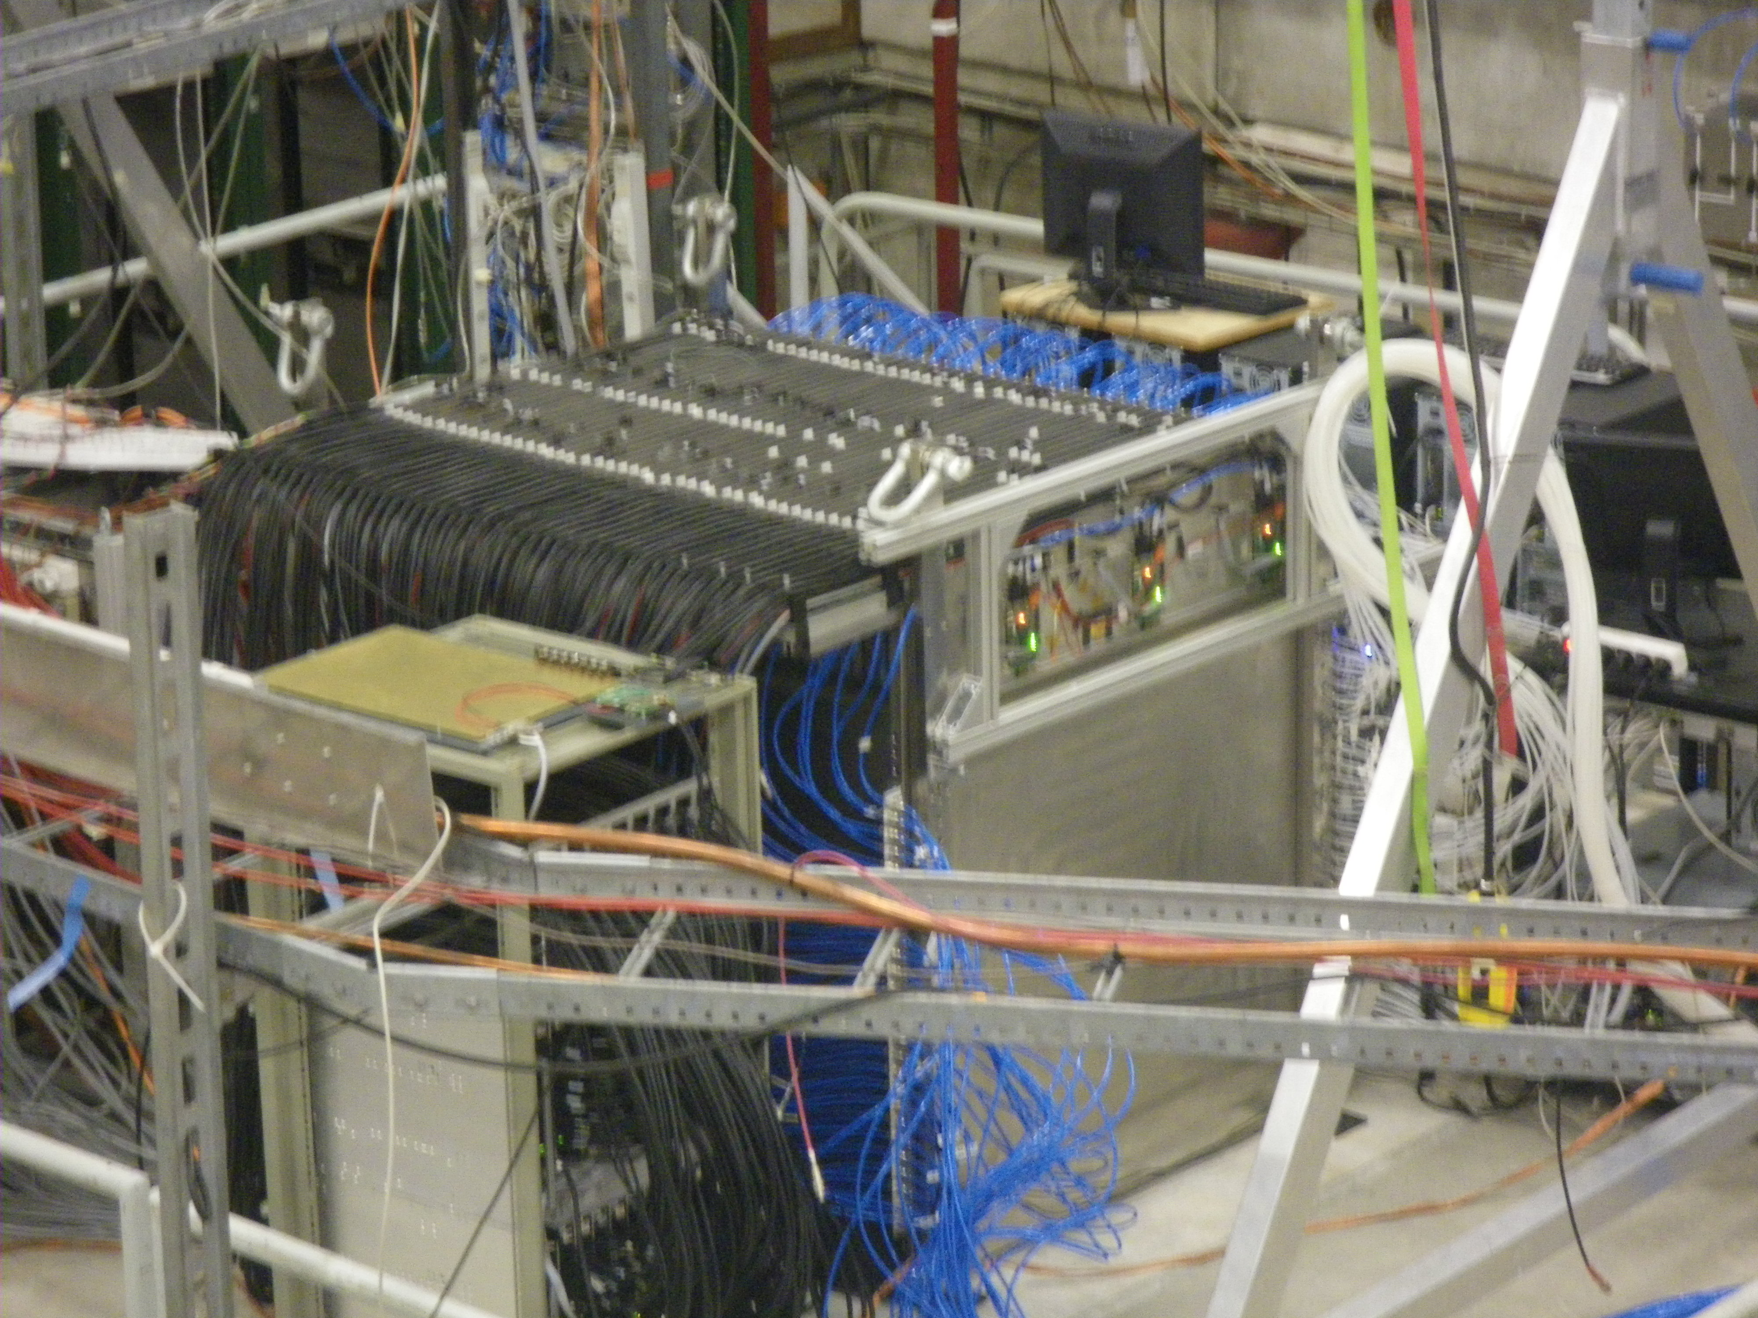
Prototype @TB
3 periods of TB in 2012
( 5 weeks)
SDHCAL Commissioning with
TrigerLess, Power-Pulsing
modes;
Thresholds choice
optimization;
Muons run calibration;
→ Pion, electron runs
to study EM and
hadronic showers;
No particle identification
detector was used.

Slide 12
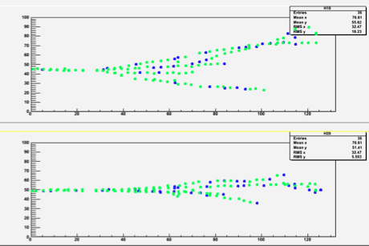
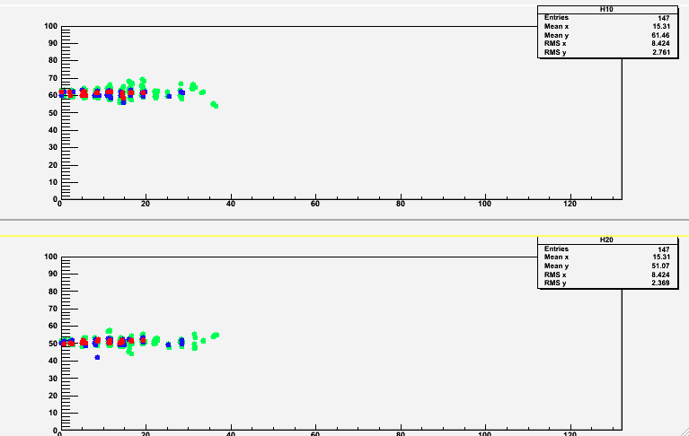
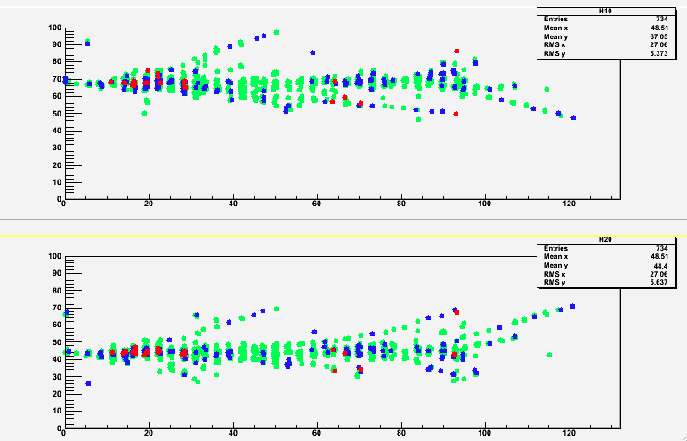
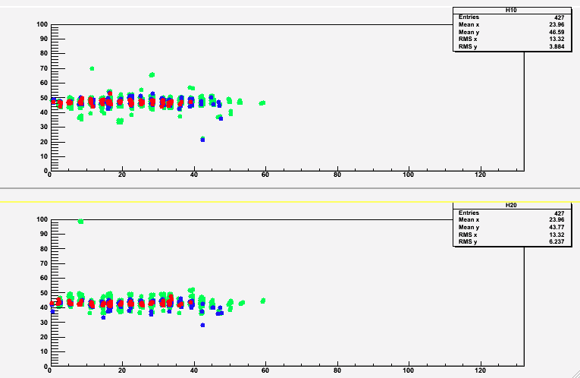
Event display
10 GeV pion
10 GeV electron
X
Z
Z
Y
Z
Z
TriggerLess
Power-Pulsed
units in cm
X
50 GeV pion
50 GeV electron
Z
Z
Y
Z
Z
Colours correspond to the three thresholds: Green (100 fC), Blue (5 pC), Red (15 pC)
Raw data, no treatment except time hit clustering

Slide 13
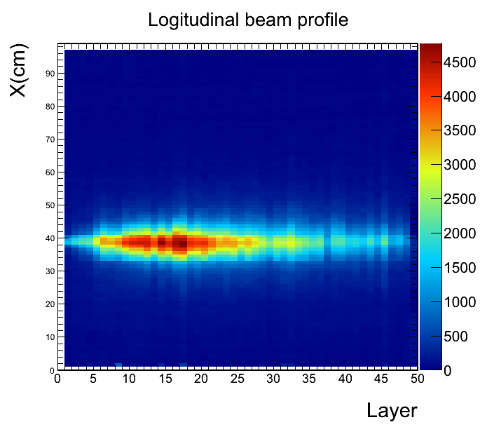
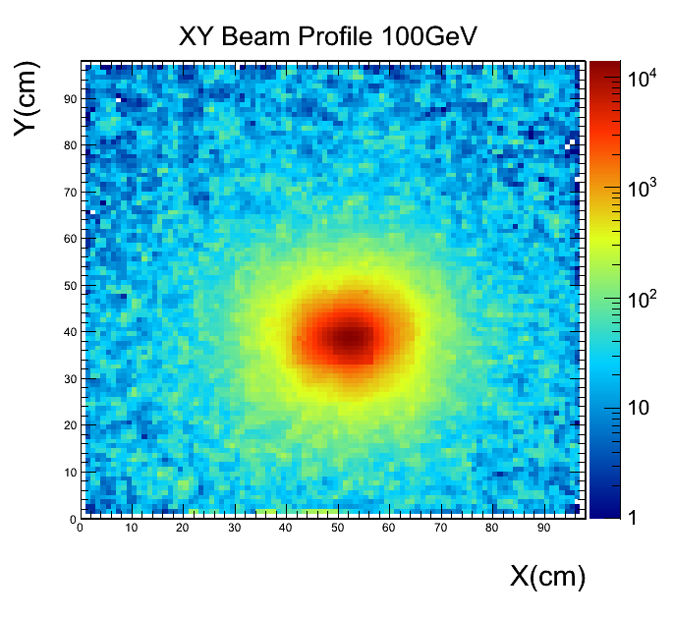
100 GeV pions
Pion 100 GeV (data)

Slide 14
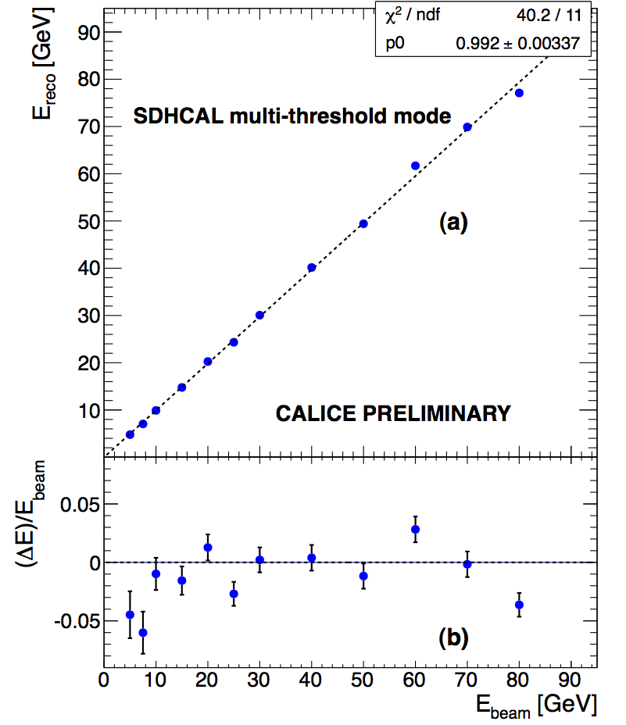
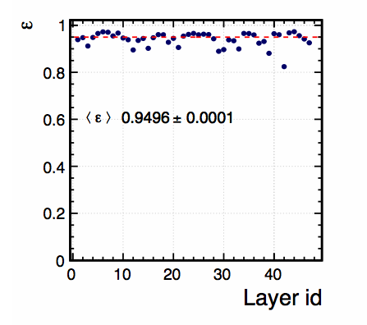
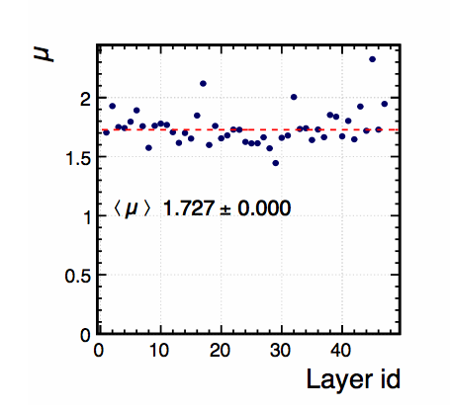
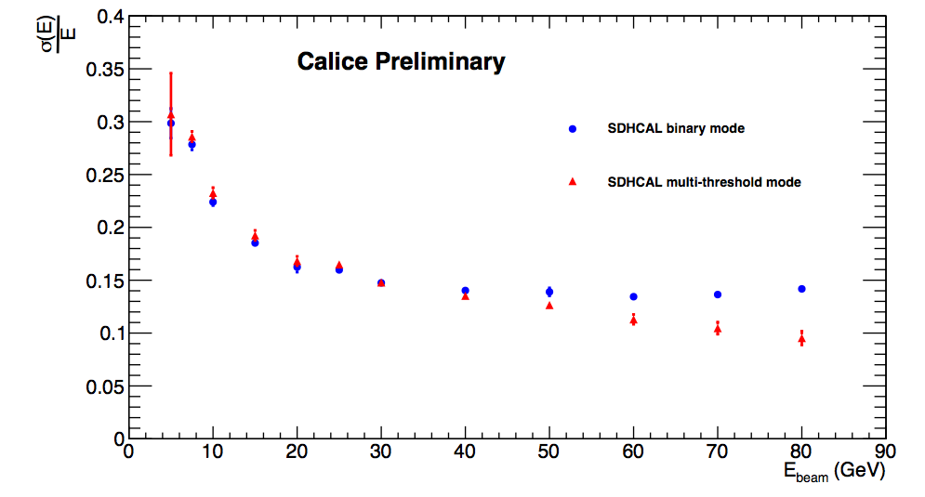
First results on linearity and energy resolution
with no calibration and with no gain correction.
Efficiency
Pad multiplicity
BINARY
Multi-threshold
Calice note CAN-037
Semi-digital improvement with respect to digital version.

Slide 15
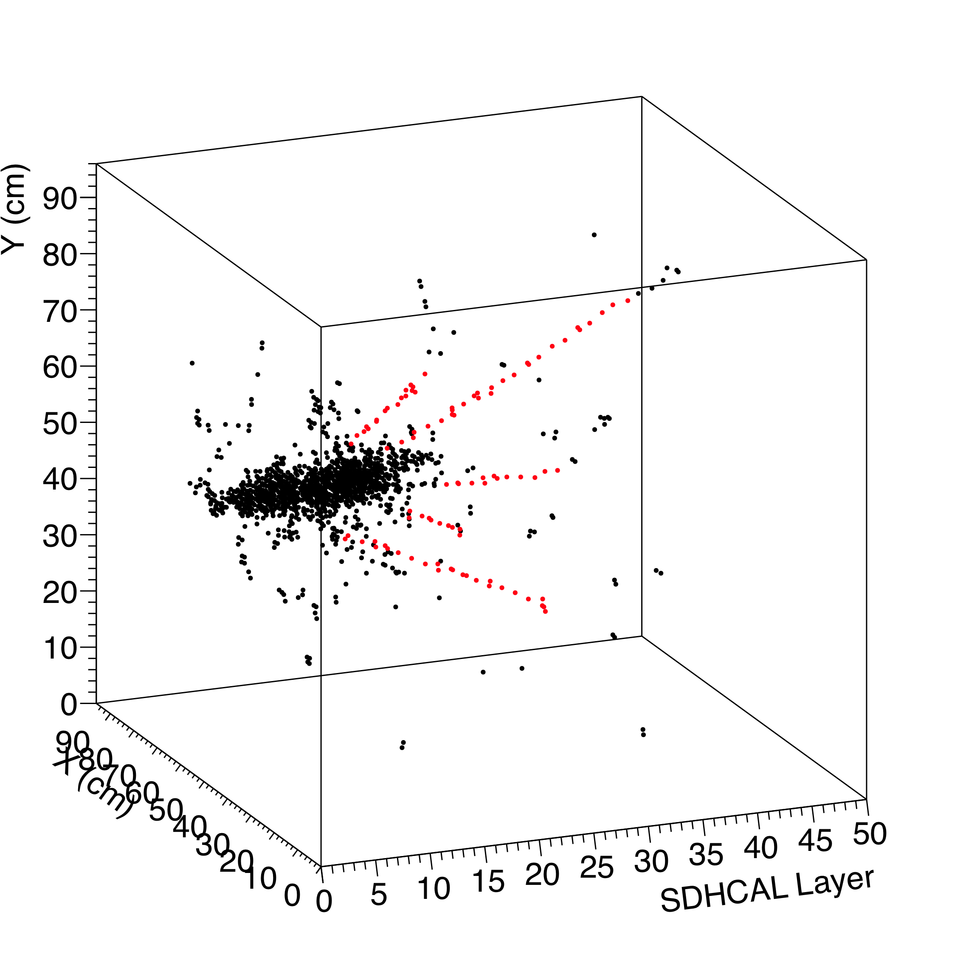
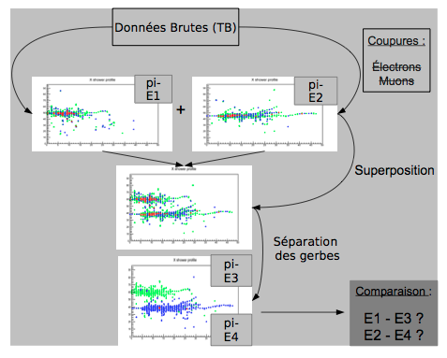
Ongoing analyses
Calibration study;
Electron-Pion separation;
Energy resolution improvement by taking into account hadronic shower
structure and calibration correction: an improvement of 7-15% already
achieved with respect to the preliminary ones obtained immediately after TB;
Imaging algorithm developments (HT, Arbor, MST) → PFA
Hough Transform
Arbor, MST..

Slide 16
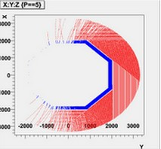
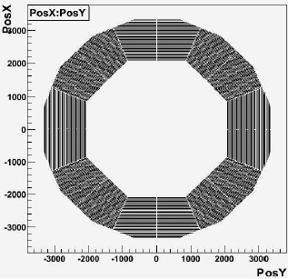
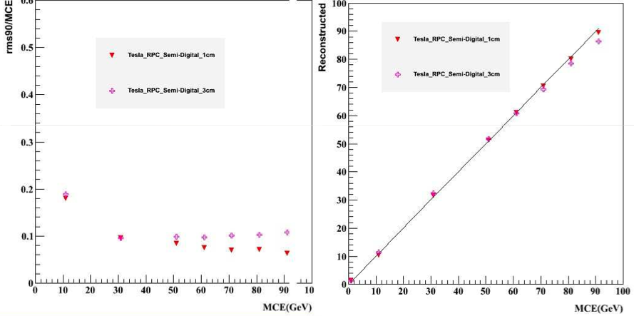
Simulation and optimization studies
SDHCAL was simulated with two mechanical structures for ILD (V and Tesla)
Studies on granularity and readout (binary vs semi-digital) were conducted. They allowed to confirm the SDHCAL choice before to start building the prototype

Slide 17
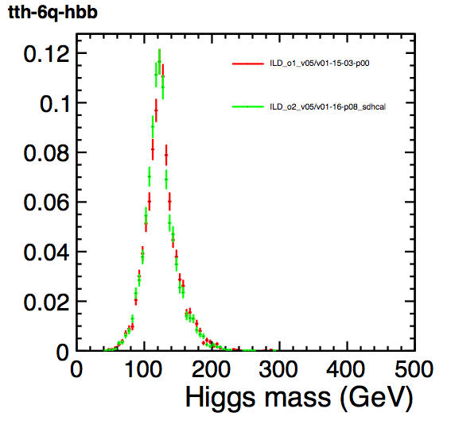
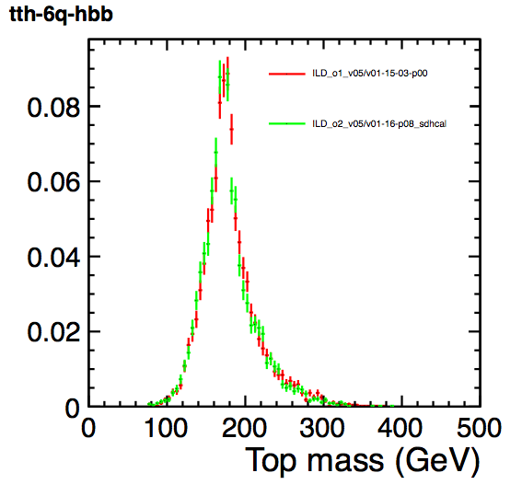
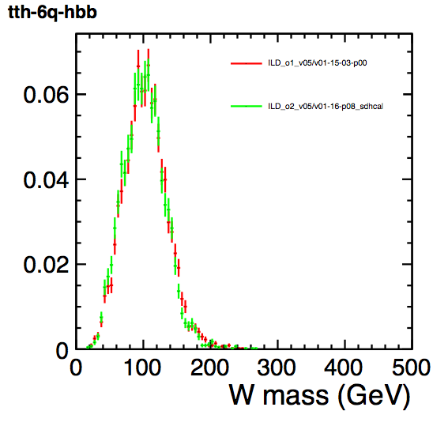
Simulation and optimization studies
The SDHCAL simulation was re-performed taking into account the constraints and the results of the prototype. The new version was used for the DBD studies, showing that same performance are obtained as for the AHCAL (albeit the PFA optimization was done for the AHCAL topology)
Higgs, top and W in the tth 8jet mode (1000 GeV).
Tomohiko Tanabe

Slide 18
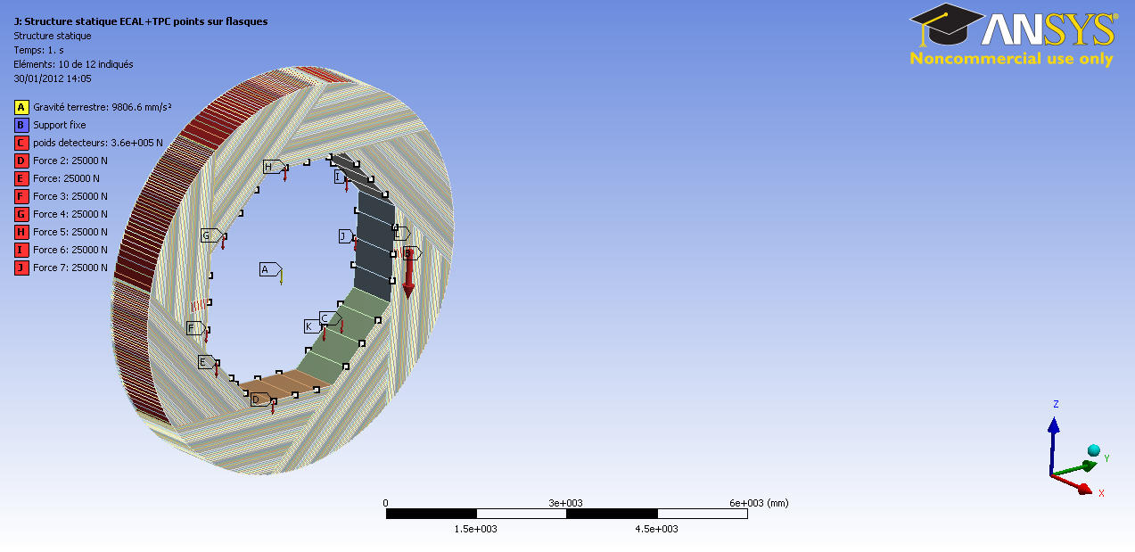





Mechanical, integration, service studies
ECAL Loads on points
Welding techniques
Building scenarios
9-15H supports
DHCAL with 8 x ECAL modules (8x2.5 t)
And TPC (4t)
180°
Deformation max SDHCAL + ECAL + TPC = 0,4 mm

Slide 19





Mechanical, integration, service studies
Few cooling scenarios were studied and compared with each other
Services were studied in detail to provide a realistic model for the ILC DBD
47
168
Mono-phasic gas like C6F14 : limited effect in case of leak, good quality/price ratio, adapted to low heat extract, simple to use

Slide 20
Road map in the 2-3 coming years
Improve on the energy reconstruction using new techniques;
-Improve on simulation (digitizer) and compare hadronic shower models to data;
Develop PFA techniques to be used to separate close-by hadronic showers;
Complete TB (ECAL+SDHCAL+…);
Publish results;
--------- ---- ----------
Build few very large GRPC detectors (2-3 m2) : gas circulation system, thickness…;
Test the new version of electronics (I2C, roll mode..) ;
Design a new ASU capable to read the large GRPC (up to 3 m²);
Develop a new DIF ( low consumption, reduced size, new functionalities);
Build a small mechanical prototype to host the few large chambers and test it.

Slide 21

New version of the readout electronics
New features in
the DAQ boards
RJ-45 (Data)
External Network chip
RJ-45 (TTC)
TTC electrical layer
(ADN2814)
ASU
connectors
Fiber/copper
(future use)
SFP cages
Spare I/Os
Clock in/out
Power out
FPGA
Large enough to embed processor if needed
The new version improves on the previous one:
Independent channels and
zero suppression
Independent ASICs (I2C)
Better dynamic range (up to 50 pC).
successfully tested;
This activity is funded essentially by AIDA
Micro USB
USB2
WatchDog
Temp
Power in
Power supply
DIF and ASU
Goldcaps to handle power pulsing ?
Current/voltage monitoring
Only one DIF per plane. For the maximum
length plane (1x3m) the DIF will handle
432 HR3 chips;
Slow control through the new HR3 I2C bus;
→ Data transmission to DAQ by Ethernet using commercial switches for concentration;
Clock and synchronization by TTC;
Synergy with R&D on fast links R&D of LHC (GBT)
Funded essentially by CIEMAT
New ASU design for large detectors under study

Slide 22




Detector improvement : to achieve same performances with very large GRPCs
Prototype circulation system
New circulation system
inlet
outlet
2 m
1 m
Mechanical structure : to be built with EBW techniques and to host few large detectors GRPCs
To be funded by AIDA

Slide 23
Conclusion and prospects
-The SDHCAL prototype is the first and up-to-now unique technological
calorimeter prototype. Its success proves that SDHCAL is a serious option
for ILD;
-SDHCAL with its fine granularity is an excellent tool to develop and exploit
PFA algorithms;
-The expertise accumulated during the conception, construction and
commissioning is very precious for physicists and technical staff in our labs;
-The SDHCAL project is an excellent environment for students;
-Few papers already published but more are being in preparation;
-The project has led to several spin-offs (TOMUVOL, CMS,..);
-We still need support from the IN2P3 to exploit the already collected
SDHCAL data and the ones we intend to have with the ECAL.
We need also to finish the R&D (very large detectors) to completely
validate the SDHCAL option.

Slide 24
Backup slides

Slide 25
Articles
Published :
-Performance of Glass Resistive Plate Chambers for a high granularity semi-digital calorimeter, Bedjidian et al, 2011_JINST_6_P02001.
-Construction of technological semi-digital hadronic prototype using GRPC, Laktineh I., Journal of Physics Conference Series, volume 293, A.N. 012077, 2011.
-First test of a power-pulsed electronics system on a GRPC detector in a 3-Tesla magnetic field, Caponetto et al, 2012_JINST_7_P04009.
In preparation :
Large GRPC detector for the future ILC SDHCAL hadronic calorimeter.
-Construction and commissioning of the SDHCAL technological hadronic calorimeter.
Calice notes :
-First results of the SDHCAL technological prototype and its addendum (CAN-037).
-Tracking within Hadronic Showers in the SDHCAL prototype using Hough Transform Technique (CAN-047).

Slide 26


Detector
Resistive coatings :
Following detailed study on the effect of resistive coating on pads
multiplicity realized using small GRPC in TestBeam conditions
it appeared that the higher the resistivity of the coating the lower the
pads multiplicity (see figure). This is of big importance to improve on
tracking capability.
Many kinds of coatings were tested on large GRPC and different
painting techniques were tried in order to ensure the best homogeneity
Some paintings like the Licron® were dropped due to long term stability
of high voltage connection.
gas
Beam
Beam

Slide 27


Detector
Painting technique
Different techniques were tested and finally the silk screen print one
is adopted. It provides homogenous and well controlled coating.
Simple tools are needed. First tests were done manually.
Painting of 20 large glass plates was then performed successfully
in a semi-automatic way.

Slide 28

Detector
Painting techniques
The measured resistivity on the 20 plates using semi-automatic
Silk screen print machine show very nice homogeneity.
R_{MAX}/R_{MIN} < 2
over 1 m² surface

Slide 29

Readout Electronics : ASIC : HR2
64-Channel
Dynamic range
Gain correct.: 8 bits
G=0 to 255 (analog G=0 to 2)
3 shapers, different Rf,Cf and gains:
Fsb1, G= ½,1/4,1/8,1/16
Fsb2, G= 1/8,1/16,1/32,1/64
3 thresholds (=> 3 DACs):
100fC, 1pC, 10pC (GRPC)
128 memory depth
Mask
872 SC registers, default config
Power pulsing:
Bandgap +ref Voltages + master I: power pulsed
POD module (power budget)

Slide 30


Readout Electronics : DIF

Slide 31
Readout Electronics : ASU
The Active Sensor Unit (ASU) board hosts the front-end electronics.
To circumvent the fabrication difficulties of the square meter
integrated circuit, the approach of assembling 6 smaller boards has
been taken.
2 ASUs are connected
two by two using an
inter-connect to form a
slab. A slab is connected
to a DIF using an
Interconnect board 3 DIFs are needed for 1m² integrated circuit

Slide 32


Detector
Homogeneity validation
Gas inlet
Acquisition based on CMS XDAQ
Gas outlet
DIF6
DIF9
DIF10

Slide 33



Digitisation
First step:
Measure GRPC analog signal with cosmic muon
Polya-distribution:
7400V Polya Fitting
Cosmic Charge
Polya Fit
Charge(pC)

Slide 34


Simulation:
A partir des données expérimentales on peut remonter au spectre de la charge associée au passage des mips dans les GRPC. On peut donc simuler l’effet des seuils et le nombre de hits laissés par une gerbe hadronique. :
,
Plusieurs modèles de gerbes hadroniques sont ensuite simulées dans le SDHCAL et comparées aux données
Y.Haddad

Slide 35


Readout Electronics : Power-Pulsing
Power pulsing was successfully tested on a 24-ASIC electronic board. The board associated to a GRPC was also successfully tested in a 3-Tesla B field in June (SPS-H2)
Trig_ext (Lemo1)
50 µs
Enable Acq
Enable PP
Vth2
Power Off
Power On

Slide 36

Electonics: ASICs stand test
A robot was used to test the 10500 ASICs
The procedure allows to select the good ASICs and calibrate them
Yield 93%

Slide 37


Slide 38


Slide 39


Assembling procedure
Clearance : 2 mm in Z
4 mm in X
Insertion test
Mechanical structure being built

Slide 40



SDHCAL acquisition system
→ Low level hardware access
→ Configuration data base software
handling devices description and settings
→ Data collection and the monitoring
Setup configuration structure
CMS Xdaq
IPNL

Slide 41

Prototype data acquisition
Trigger less mode : Recording events until memory is full, then
data transfer and restart.
Power-Pulsed mode : ASIC is idle between two spills.
According to the time spill structure
( NX400 ms (PS)*, 10 s(SPS) every 45 s)
No gain correction applied for this TB.
Physics events are built as follows:
Hits left by interacting particles
* N is often 1 and sometimes 2-3 spills/cycle

Slide 42

Y.Haddad

Slide 43


Calibration :
Etude de la calibration de SDHCAL est en cours afin d’améliorer la résolution de l’énergie. Cela inclut l’étude de l’efficacité et la multiplicité des chambres localement à l’aide des muons et des cosmiques. La dépendance de la performance en temps (effet température…) peut aussi analysée d’une manière indirecte.
Y.Haddad

Slide 44

Nb of hits versus spill time depth

Slide 45

Y.Haddad

Slide 46


The selection should not impact the hadronic shower resolution
40 GeV pions
Before selection
After selection
40 GeV electrons (no cut)

Slide 47

5 GeV
7.5 GeV
10 GeV
15 GeV
20 GeV
25 GeV
2-σ Gaussian fits are used
30 GeV
40 GeV
50 GeV
60 GeV
70 GeV
80 GeV

Slide 48

Energy estimation :
The thresholds weight evolution with the total number of hits obtained by minimizing a χ²
Χ² = (E_{beam}-E_{rec})²/E_{beam}
E_{rec =} α (N_{tot}) N₁ + β(N_{tot}) N₂ + γ(N_{tot}) N₃
N₁,N₂ and N₃ : exclusive number of hits associated to first, second and third threshold.
α, β, γ are quadratic functions of the total number of hits (N_{tot})
For instance α = α₀ + α₁ N_{tot} +α₂ N²_{tot}
Events of September runs corresponding to energies : 5, 10, 30 , 60 and 80 GeV were used to fit the 9 parameters. This represents more than 50 k events.

Slide 49


H6
Aout-Septembre
H2
Novembre

Slide 50

Present SDHCAL versus DHCAL (after 3 years of calibration studies)

Slide 51


Present SDHCAL versus AHCAL (after few years of calibration studies)
AHCAL after 4 years of data taking
AHCAL after 6 years of data taking, using NN

Slide 52

A.Steen

Slide 53

A.Steen

Slide 54

Separation of two close-by pions of 10 GeV each
R.Eté

Slide 55



High-Rate GRPC
High-Rate GRPC may be
needed in the very forward
region
Semi-conductive glass (10¹⁰ Ω.cm)
produced by our collaborators
from Tsinghua University was
used to build few chambers.
4 chambers were tested
at DESY as well as standard
GRPC (float glass)
Performance is found to be excellent at high rate
for GRPCs with the semi-conductive glass and can be used in the very forward of ILD region if the rate exceeds 100 Hz/cm² in future ILD upgrades

Slide 56
HARDROC3
I2C link (@IPNL)
PLL: integrated before in a builiding block, first measurements are very good
Input frequency 2.5 MHz =>output frequency: 10, 20, 40, and 80 MHz available
Bandgap: new one with a better temperature sensitivity, tested in a building block
Roll mode
Triple voting
Temperature sensor: tested in a building block, slope – 6mV/°C
Die size ~30 mm2 (6.3 x 4.7 mm2)
To be packaged in a TQFP208
Submitted at the end of Feb 2013 (SiGe 0.35µm)
Currently tested.
Omega-IPNL

Slide 57
ANALOG PART: FSB LINEARITY
FSB0: 5σ noise limit= 15 fC
FSB0
FSB1
FSB2
Up to 10 pC
Up to 50 pC

Slide 58
DIF: Designed for ILD SDHCAL
Only one DIF per plane. For the maximun lenght plane (1x3m) the DIF will handle 432 HR3 chips
Slow control through the new HR3 I2C bus
Data transmision to DAQ by Ethernet using comercial switches for concentration
Clock and syncronization by TTC
USB 2.0 for debugging
External Network chip
RJ-45 (Data)
RJ-45 (TTC)
TTC electrical layer
(ADN2814)
ASU
connectors
Fiber/copper
(future use)
SFP cages
FPGA
Spare I/Os
Clock in/out
Power out
Large enough to embed processor if needed
Micro USB
USB2
WatchDog
Temp
Power supply
Power in
DIF and ASU
Goldcaps to handle power pulsing ?
Current/voltage monitoring
CIEMAT-IPNL

Slide 59
New ASU layout options
As there will be only one DIF per plane, the distribution of the ASU boards in the plane will be rearranged to reduce the number of conections between the DIF and the plane
A
B
ASU 1
ASU 3
ASU 5
DIF
ASU1
ASU2
ASU3
DIF
ASU 2
ASU 4
ASU 6
First ASU extension for drivers & connectors
In option B the common signals for the plane have to be sent twice (one per slab) while in option B they can be sent only once
But, option A looks more risky from the point of view of the feasibility of the 1m long ASU boards.
In both options the ASUs connected to the DIF will be a bit longer to host the connectors and the buffers for driving the long lines. This extension provides more freedom for the connectors selection and moves the drivers heat disipation to the ventilation area

Slide 60

Acquisition system
This scheme failed and was replaced by a hybrid one using both the DCC( fast commands, synchronization, ramful) and USB( data collection).

